Slide 1
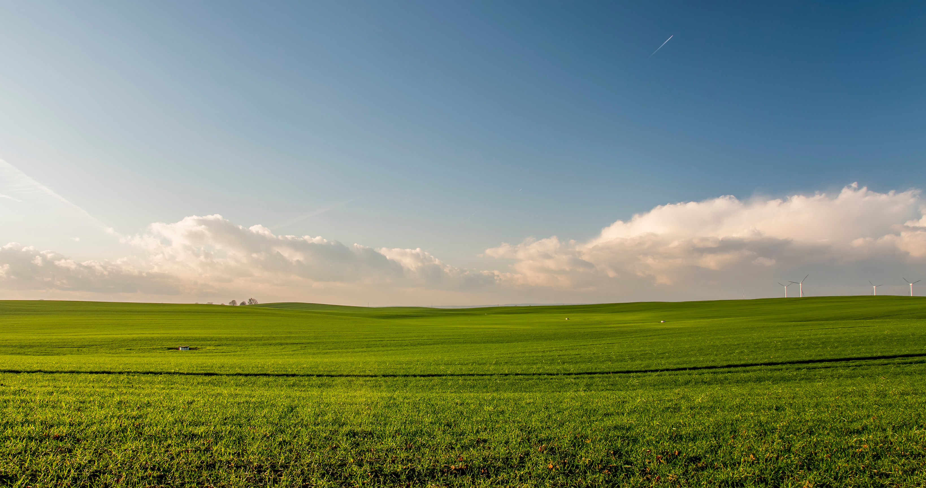


AI AGROBOT: INTELLIGENT AGRICULTURE CHAT ASSISTANT
presented by:
PASUNURI POOJA

Slide 2
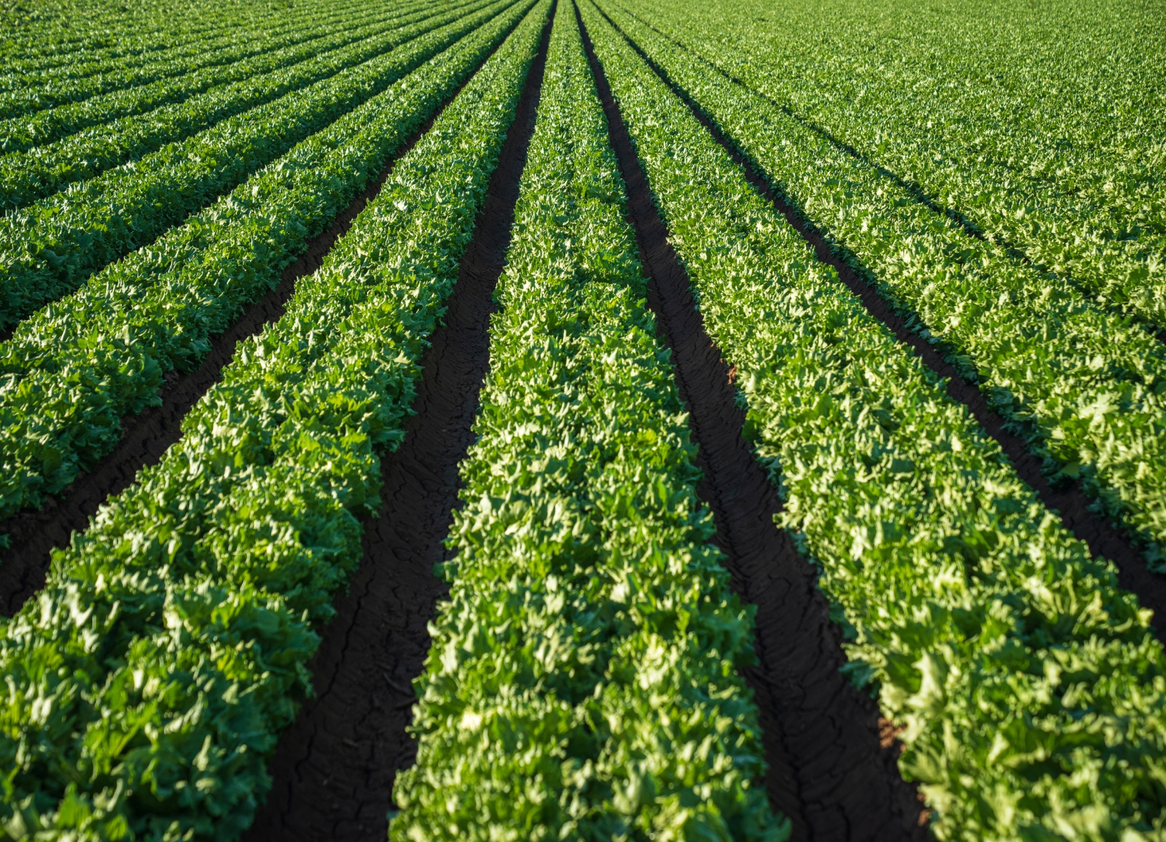

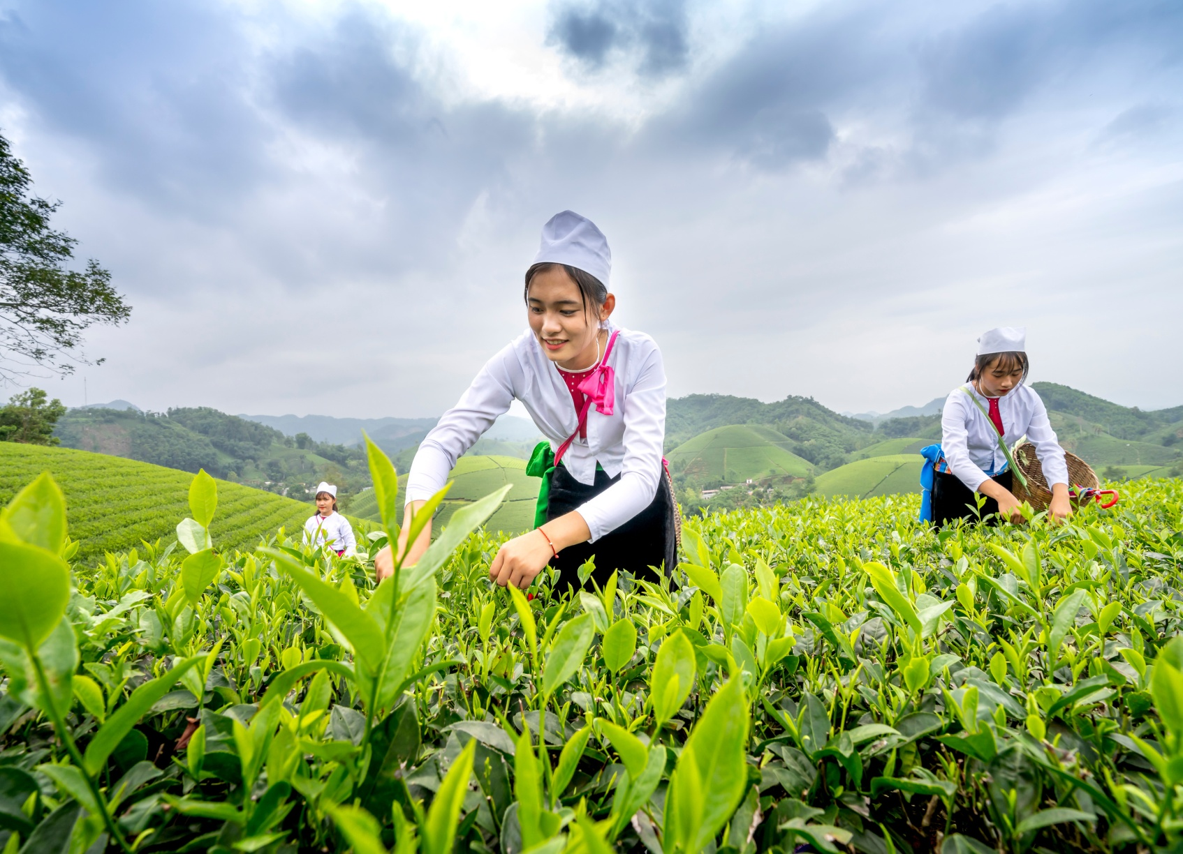
02
About Project
AI AgroBot is an intelligent chat assistant designed to help farmers with agricultural guidance.
It uses Artificial Intelligence (AI) and Natural Language Processing (NLP) to understand farmers’ questions.
The bot provides real-time answers about crops, fertilizers, pests, and weather updates.
It aims to make farming smarter, easier, and more productive.
The system works through a simple chat interface that can be used on mobile or computer.
It connects to weather APIs and crop databases to give accurate and updated information.
AI AgroBot helps reduce farmers’ dependency on experts and promotes digital agriculture.

Slide 3
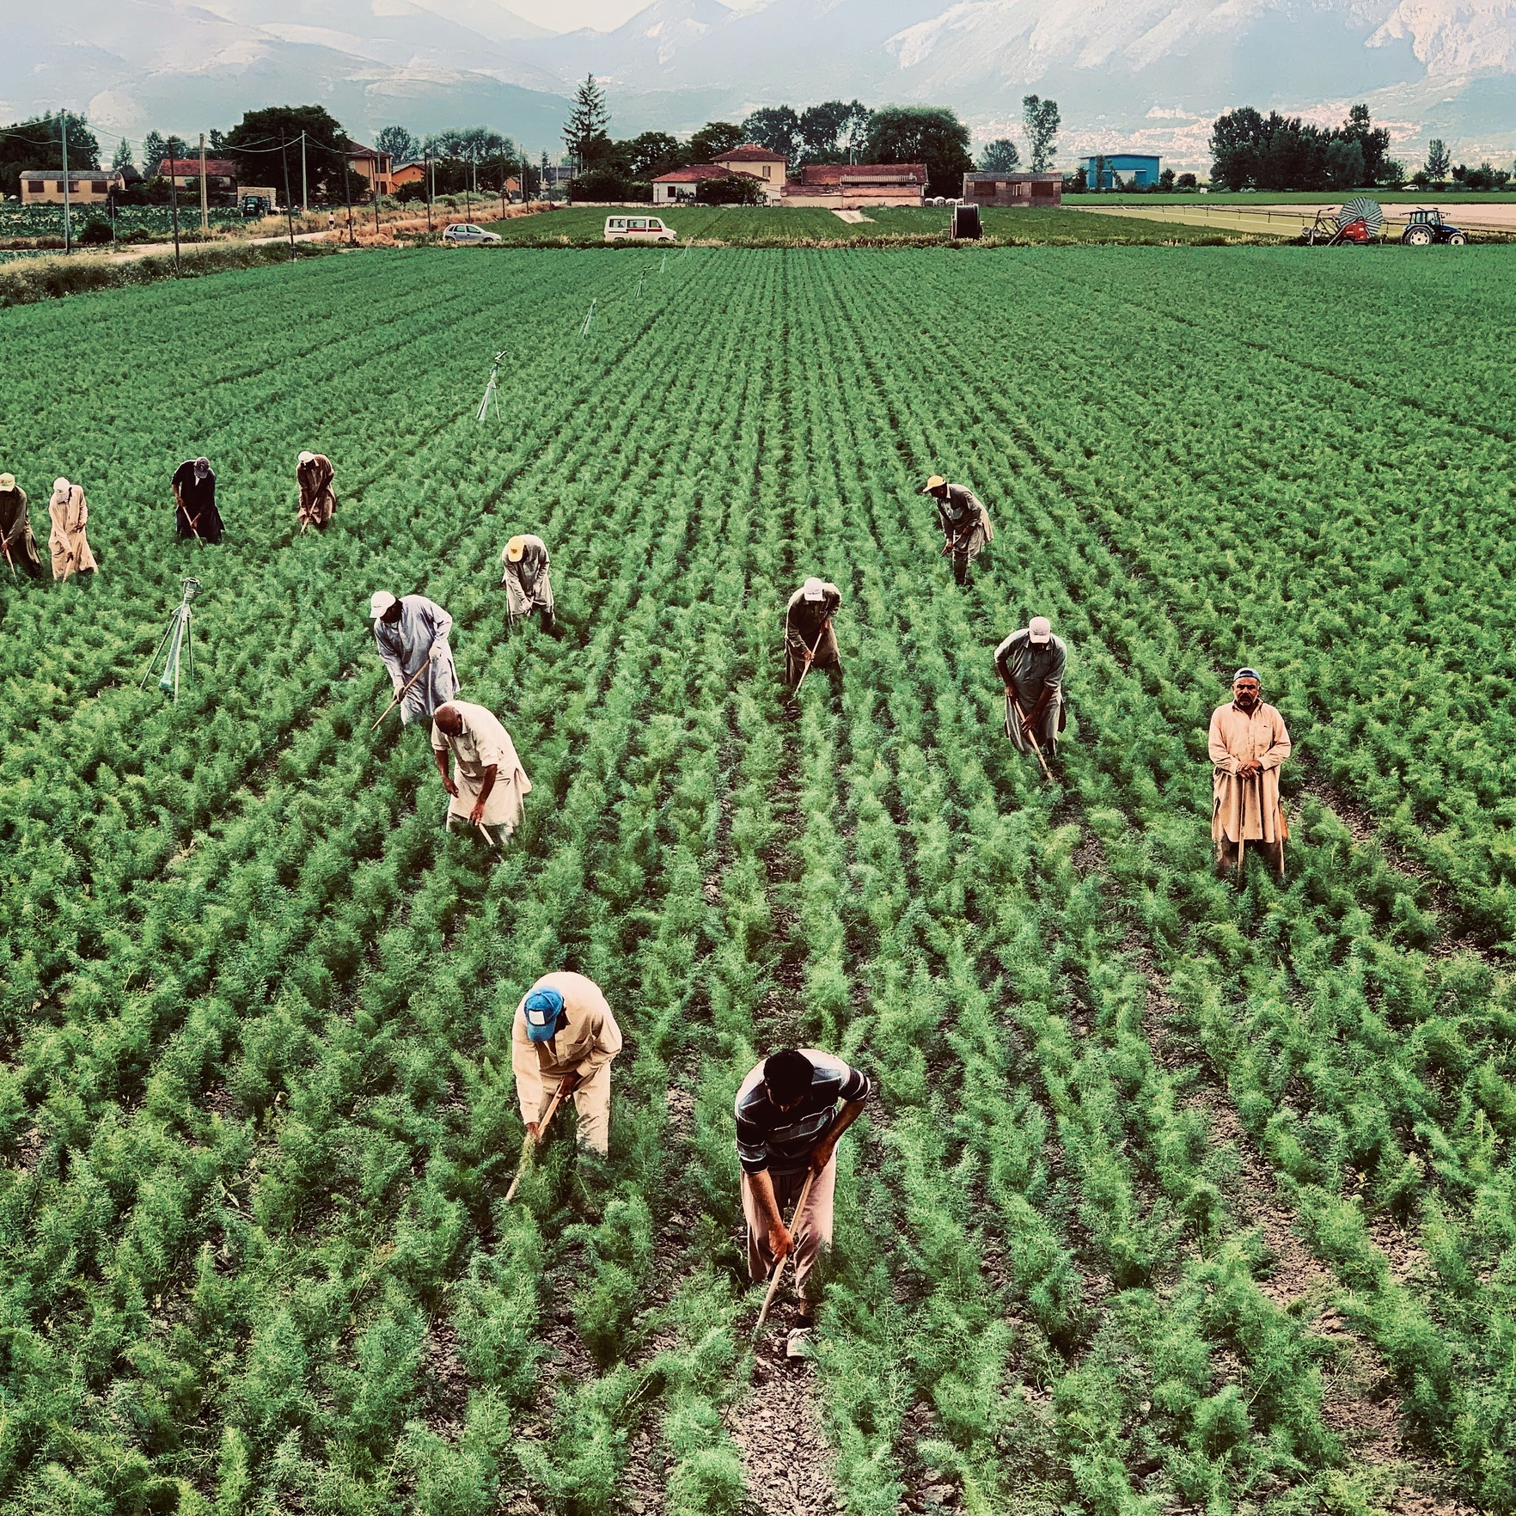
03
objectives
To develop an AI-powered chat assistant for farmers.
To support multiple languages for easy farmer interaction.
To provide real-time solutions for crop, fertilizer, and pest management.
To give accurate weather forecasts and market price updates.
To use Natural Language Processing (NLP) for understanding user queries.
To promote smart and sustainable agriculture through technology.
To make agricultural knowledge accessible anytime and anywhere.

Slide 4
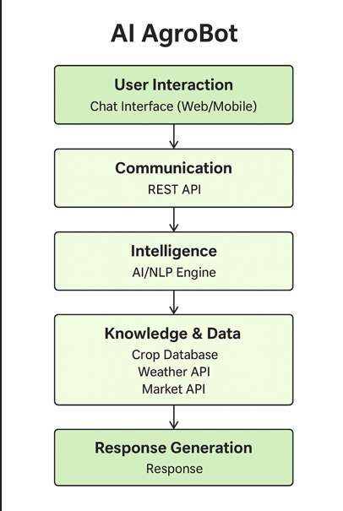
04
System architecture

Slide 5
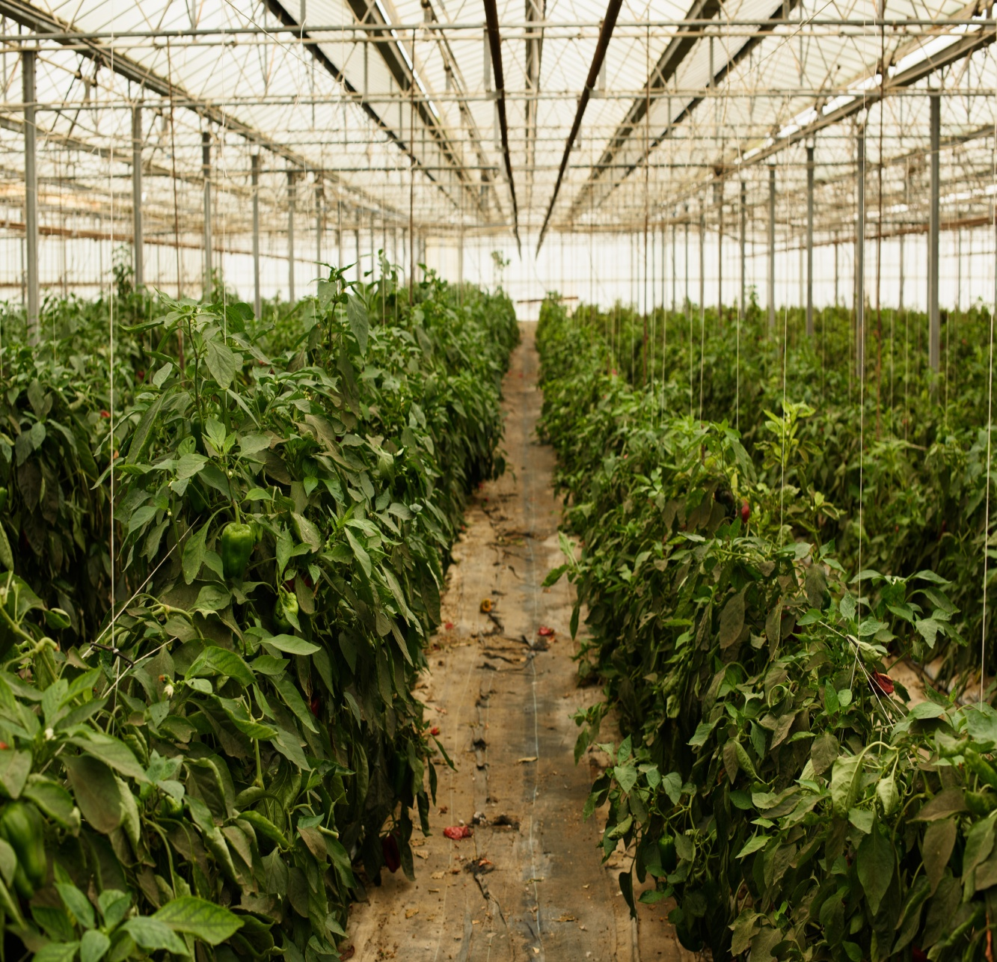
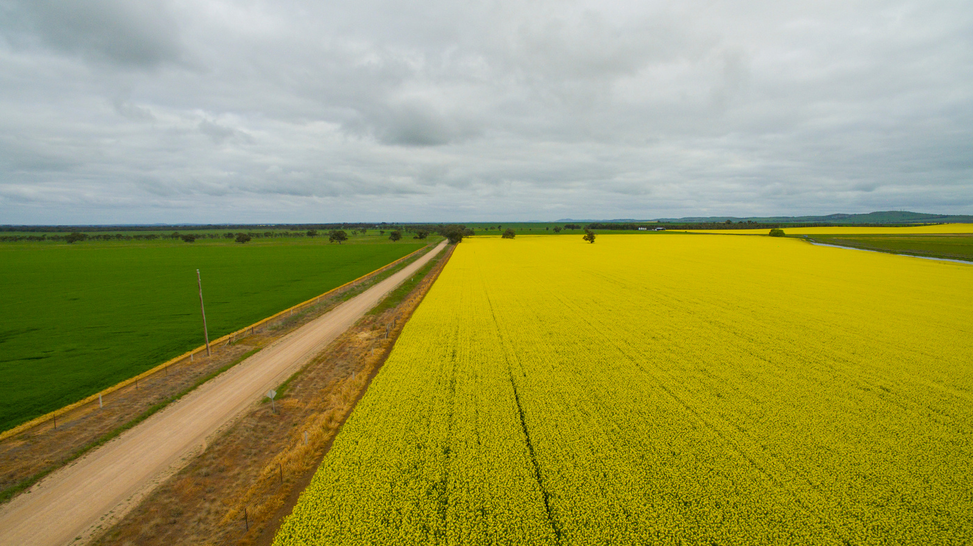
Technology used in project
Frontend: HTML5, CSS3, JavaScript, Bootstrap / Tailwind CSS
Programming Language : Python
AI & NLP: spaCy, NLTK, Transformers, Language Translation API
Database: SQLite
External APIs: Weather API, Crop & Market Price Data
Tools: VS Code / PyCharm, Git & GitHub
05

Slide 6
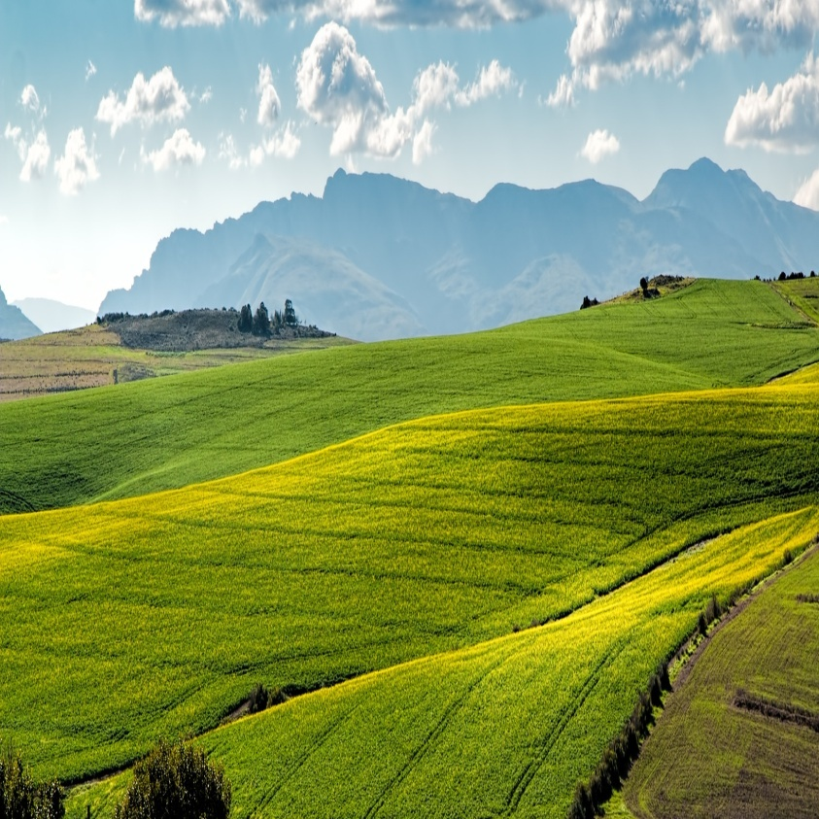

06
Integrates AI and NLP to provide intelligent, real-time assistance to farmers.
Enhances decision-making in crop management, fertilizer use, and pest control.
Utilizes live weather and market data to deliver accurate, data-driven insights.
Supports multilingual interaction for easy communication with farmers in local languages.
Promotes sustainable and smart farming through automation and advanced analytics.
Advanced Features of AI AgroBot for Smarter Farming

Slide 7
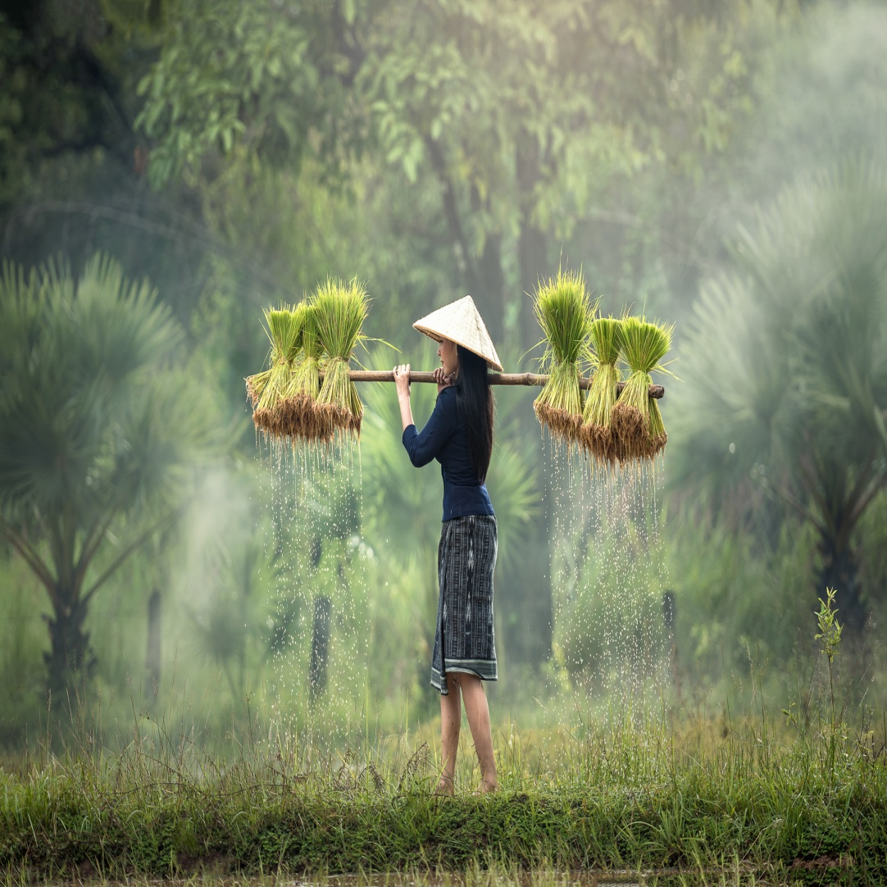
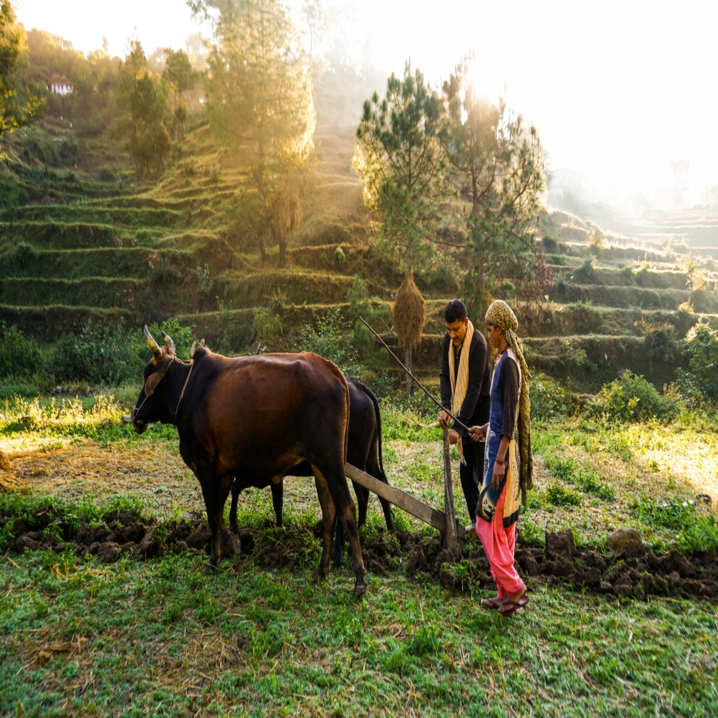
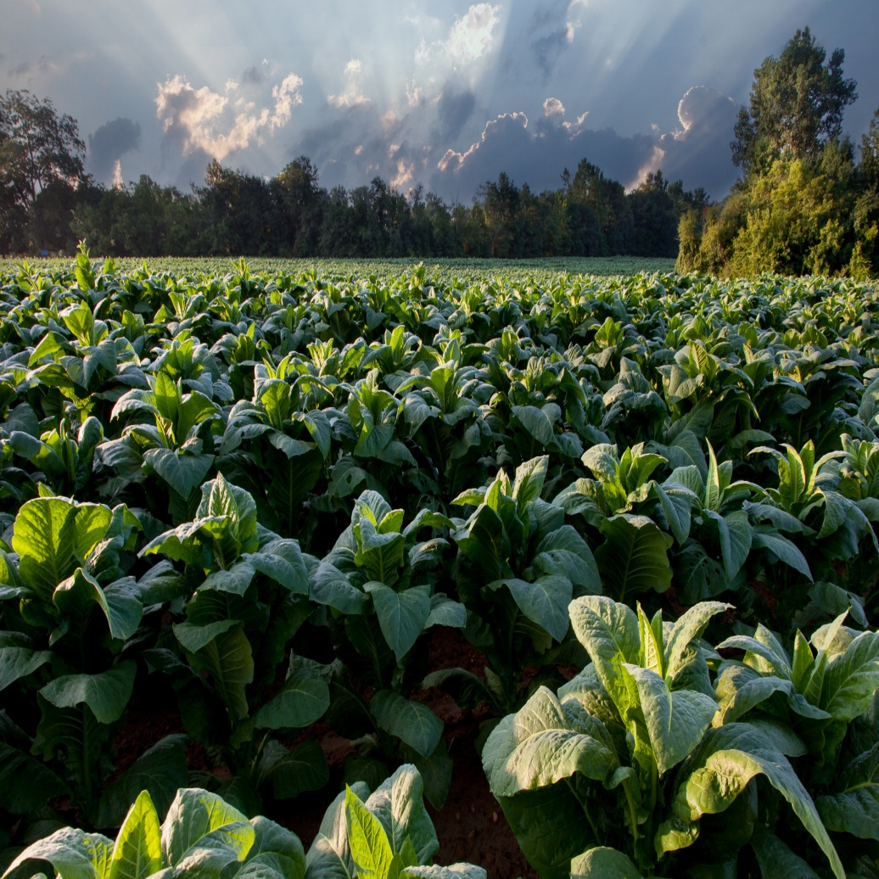
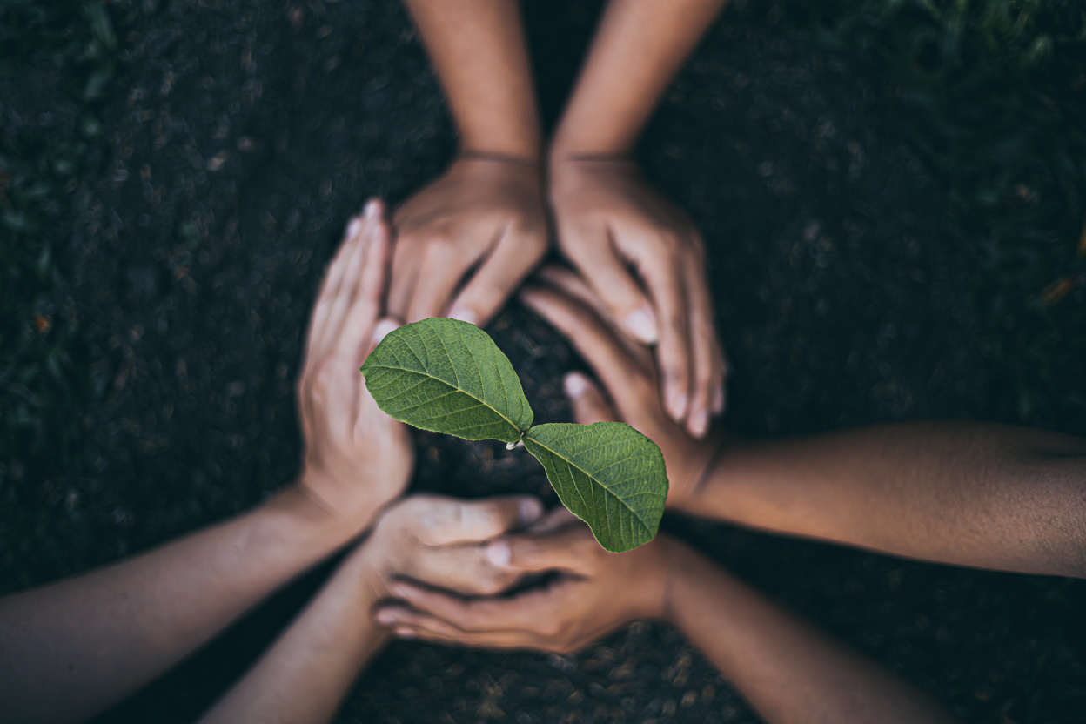
07
Conclusion
The AI-based Agriculture Chatbot serves as a smart digital assistant for farmers, providing instant and accurate answers to their farming-related queries.
By using Natural Language Processing (NLP) and Machine Learning, the system helps farmers make better decisions about crops, fertilizers, and pest management.
This technology not only saves time and effort but also promotes sustainable farming practices.
Overall, the AgriBot represents a major step toward modernizing agriculture through AI innovation and digital empowerment.

Slide 8
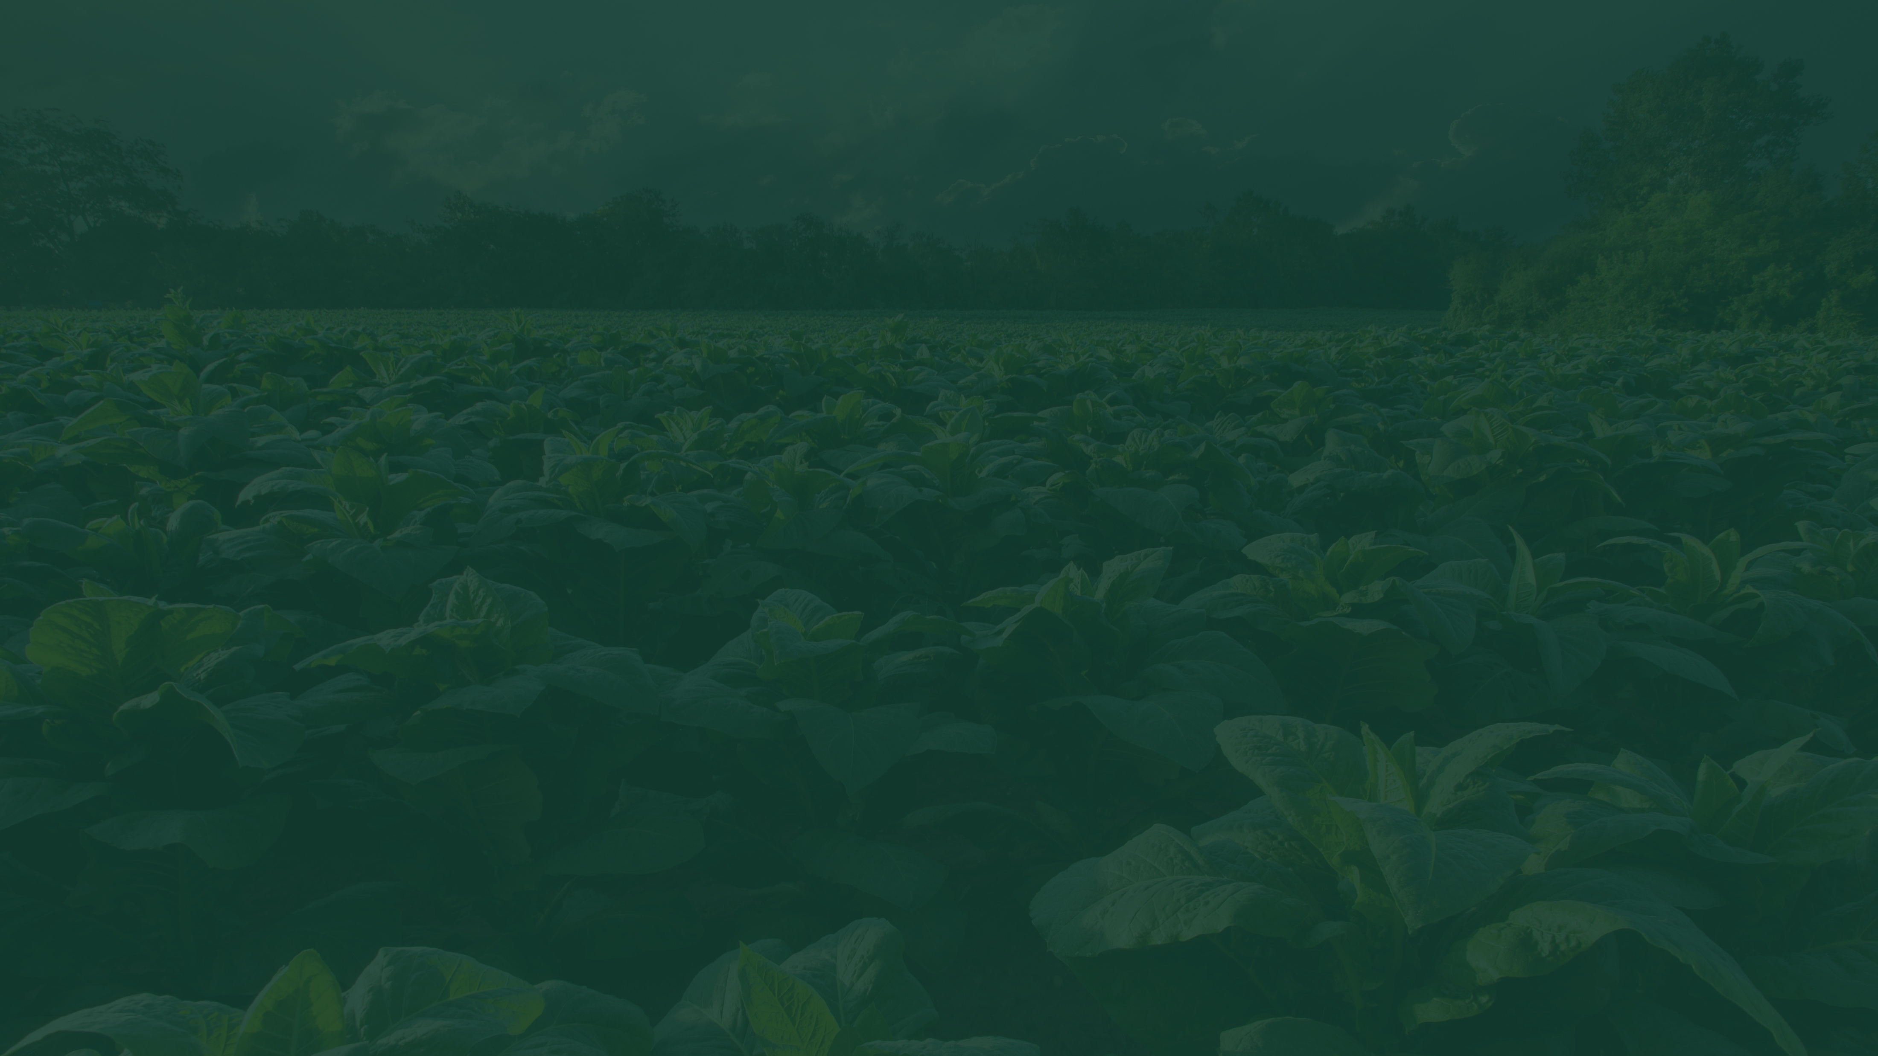

Thank You!

